Slide 1
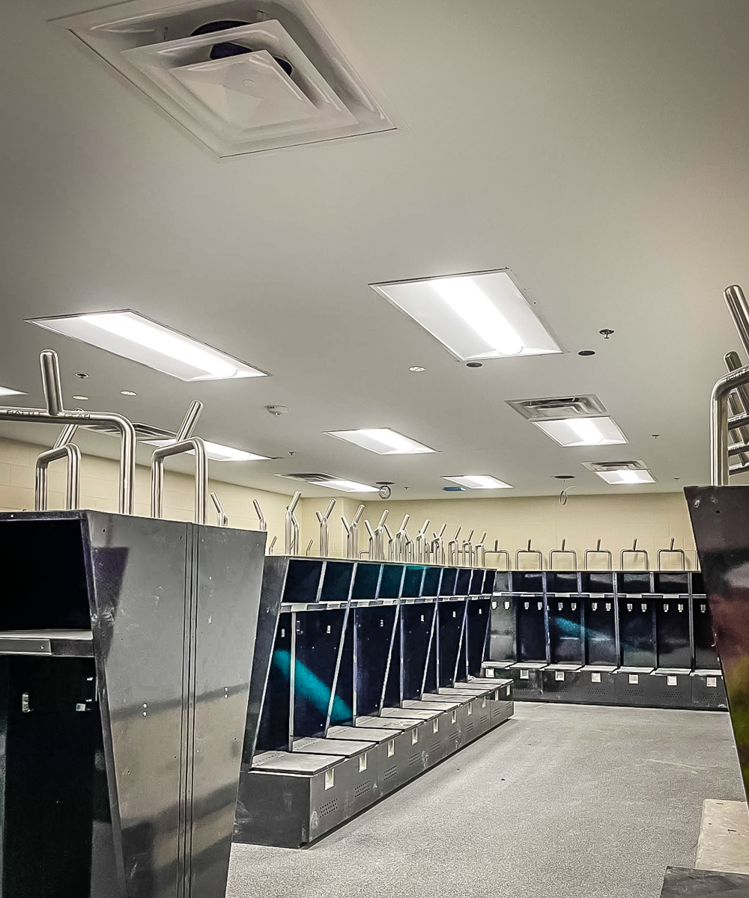
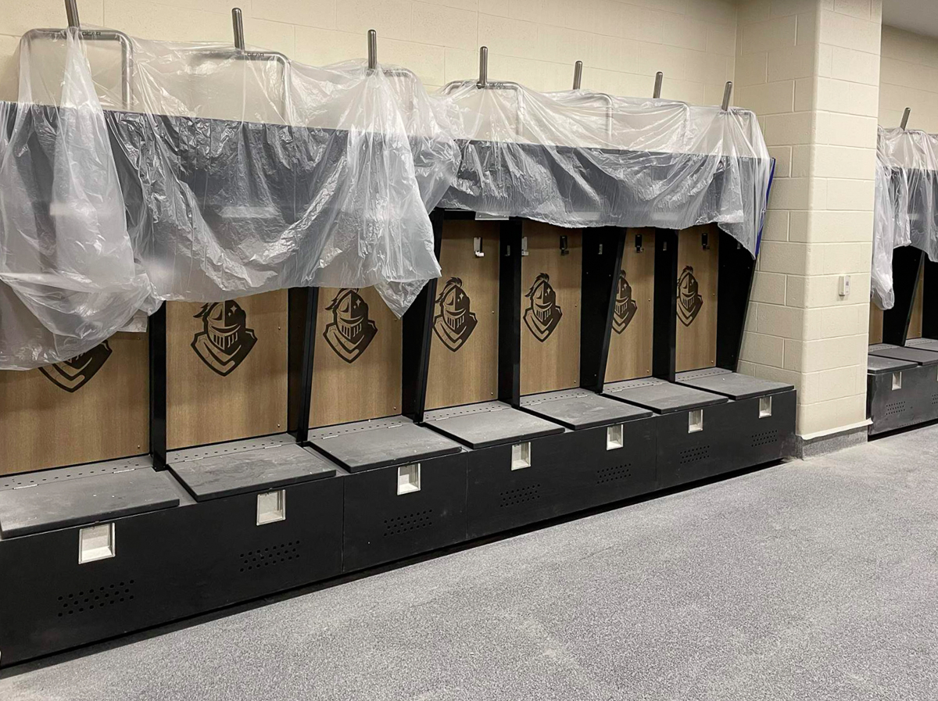
EAGLE MOUNTAIN HS
Hard ceiling, paint, and flooring have been installed in the fieldhouse locker rooms.

Slide 2
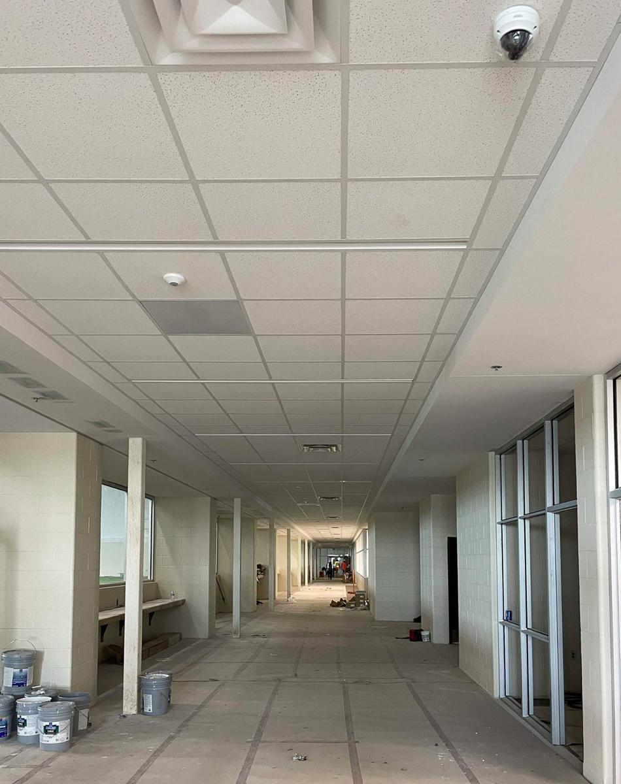
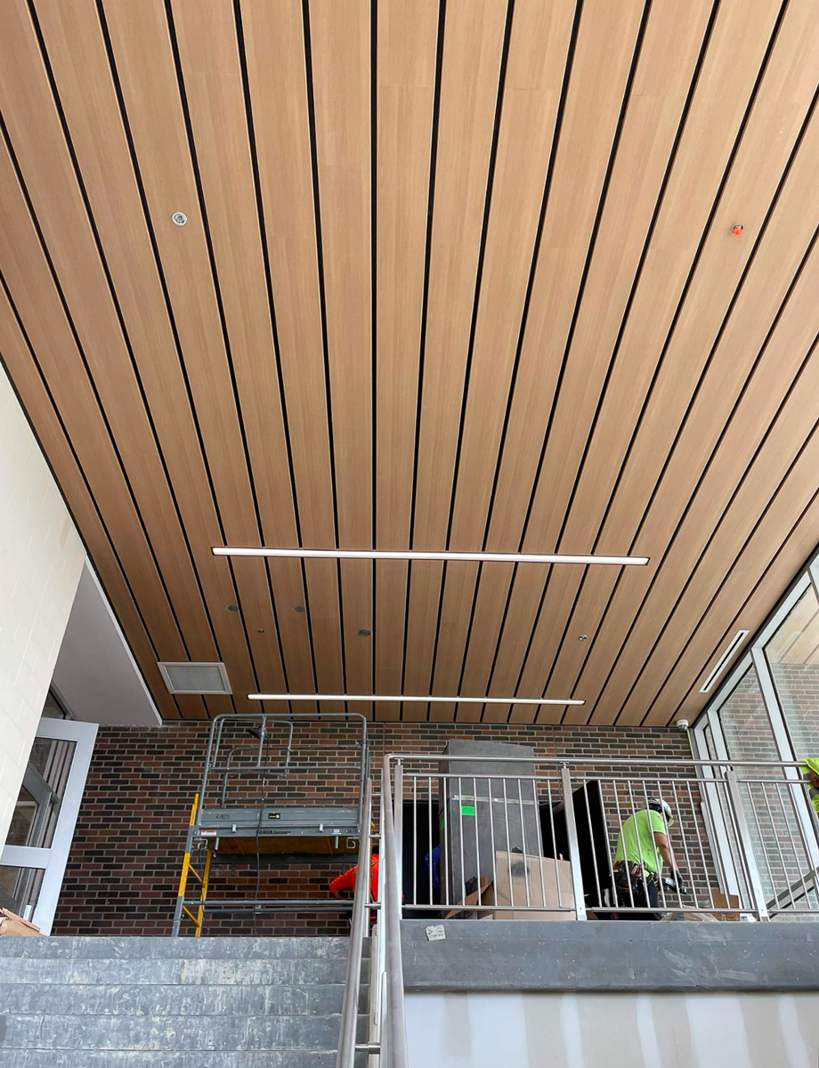
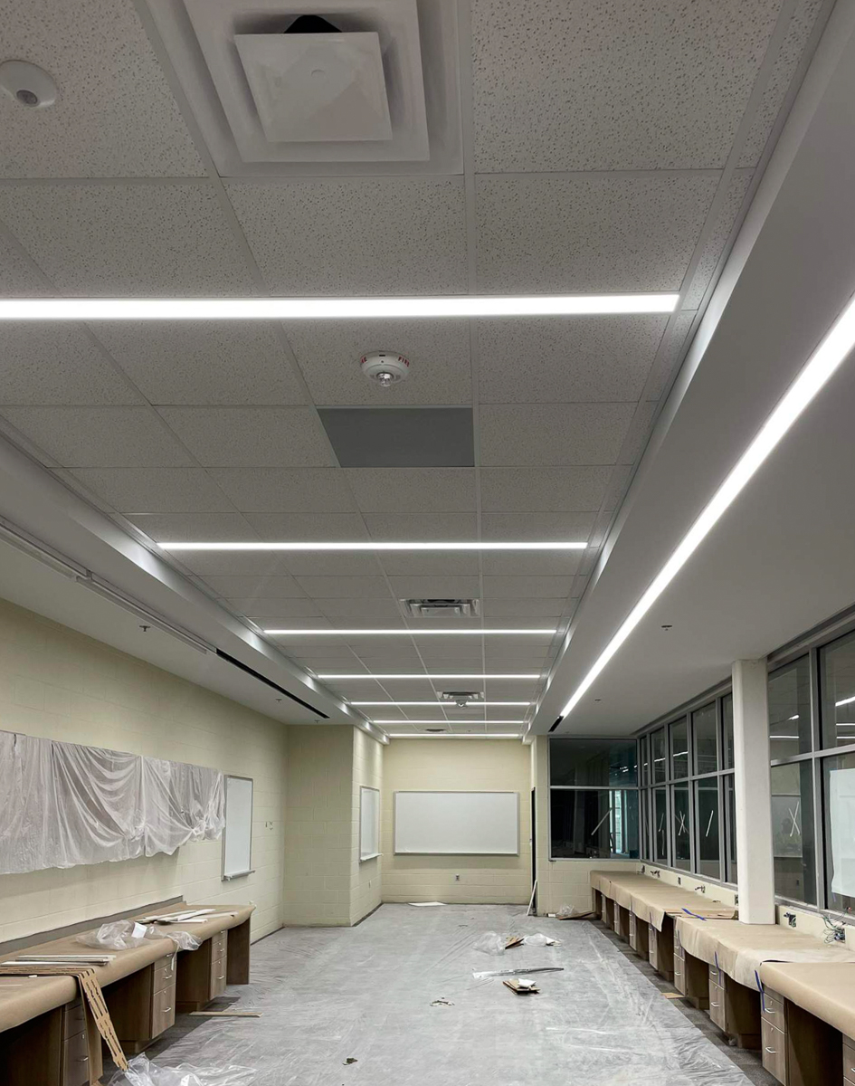
Ceiling tiles, flooring, and protection have been installed in the lower level of the fieldhouse.
Carpet, ceiling tiles, millwork, and accessories have been installed the coachs’ office.
Fieldhouse stair ceiling has been installed.

Slide 3
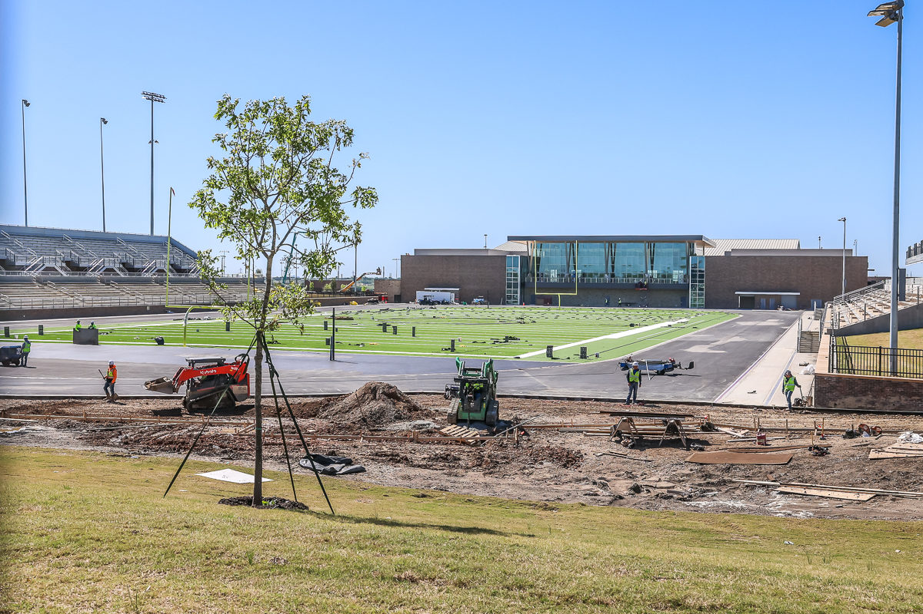
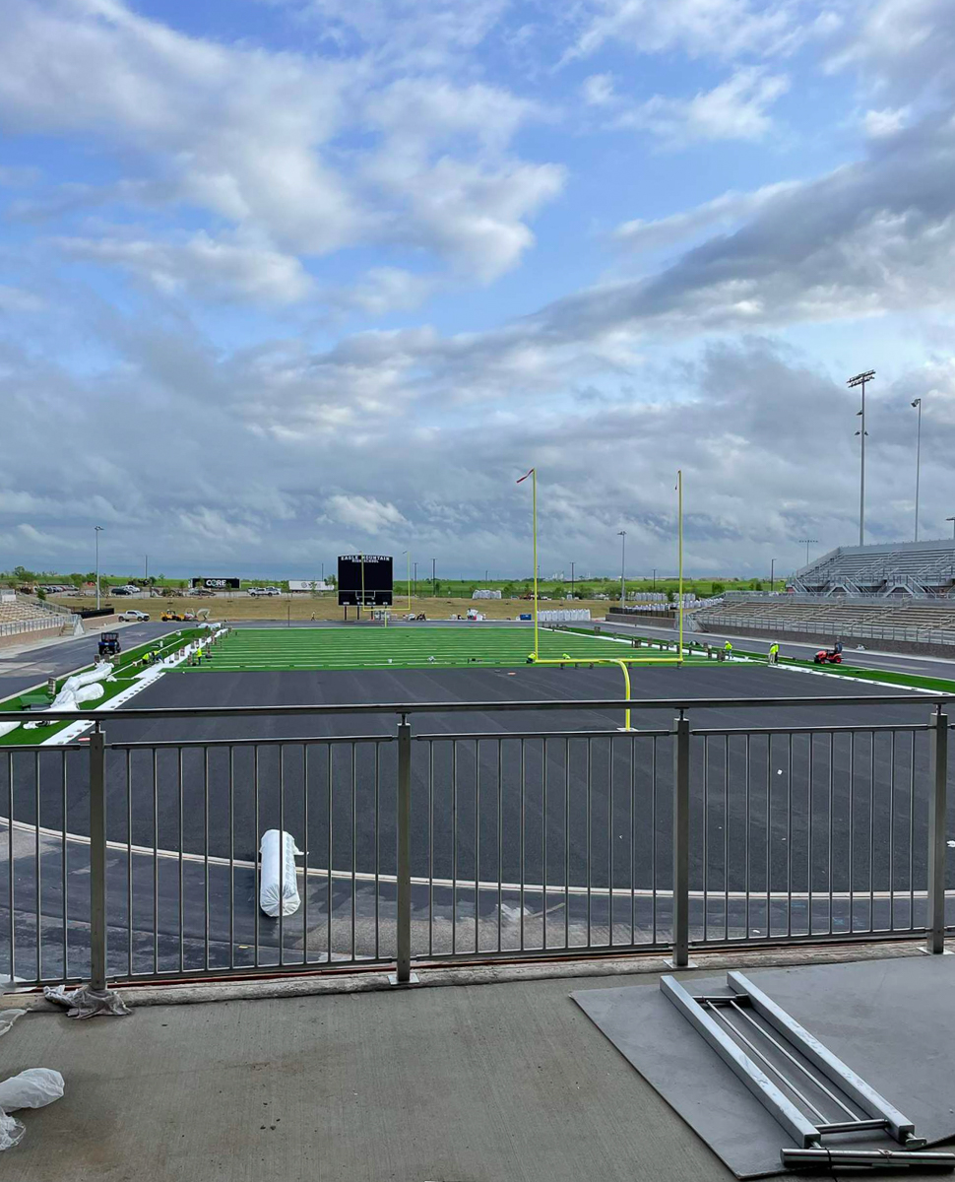
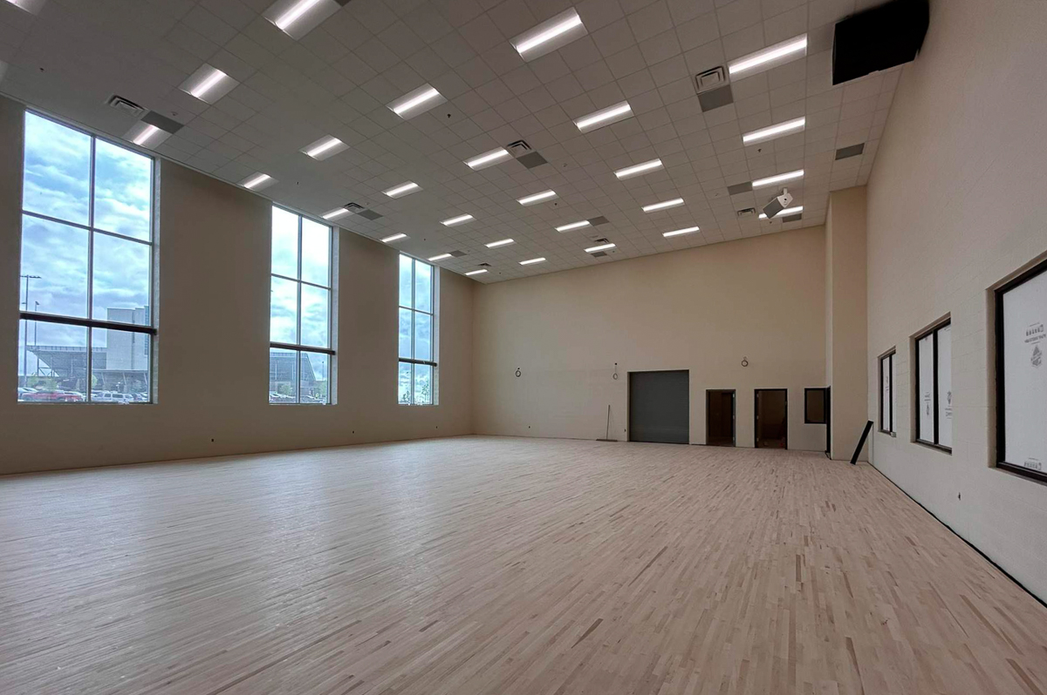
Stadium turf installation ongoing. Weight room balcony railing is complete.
Cheer gym wood flooring is installed. All overhead work complete and ceiling tiles have been installed.

Slide 4
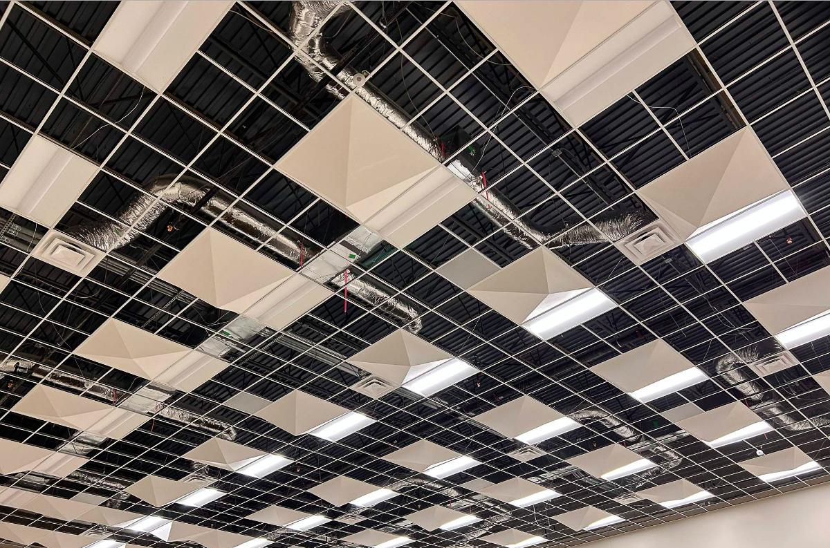
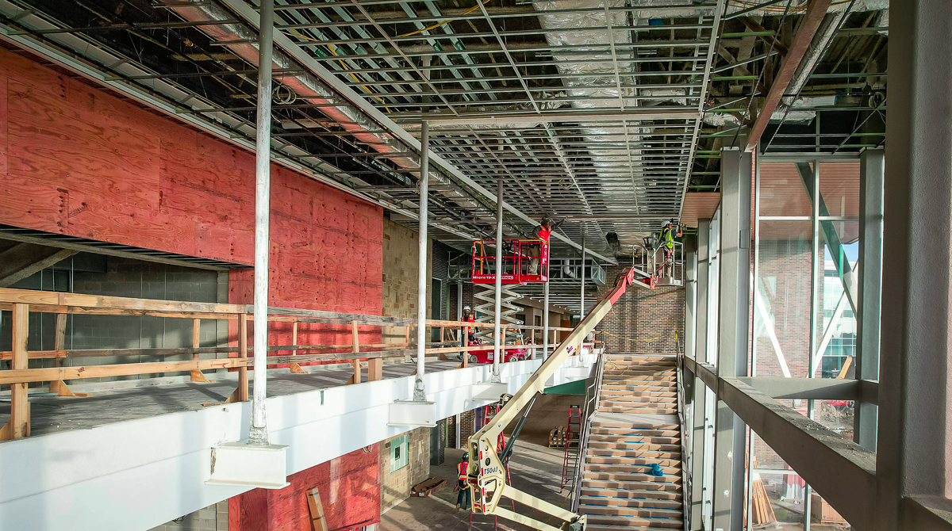
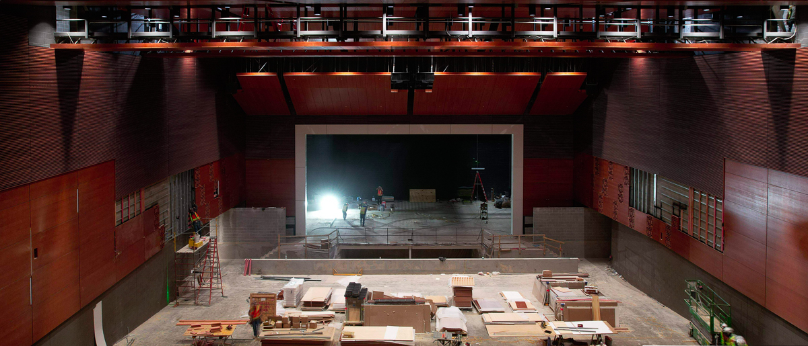
Auditorium wood panel installation is nearing completion. Auditorium seating is scheduled for delivery on April 19.
Auditorium lobby ceiling installation is ongoing.
Acoustical ceiling panels have been installed in band hall areas.

Slide 5
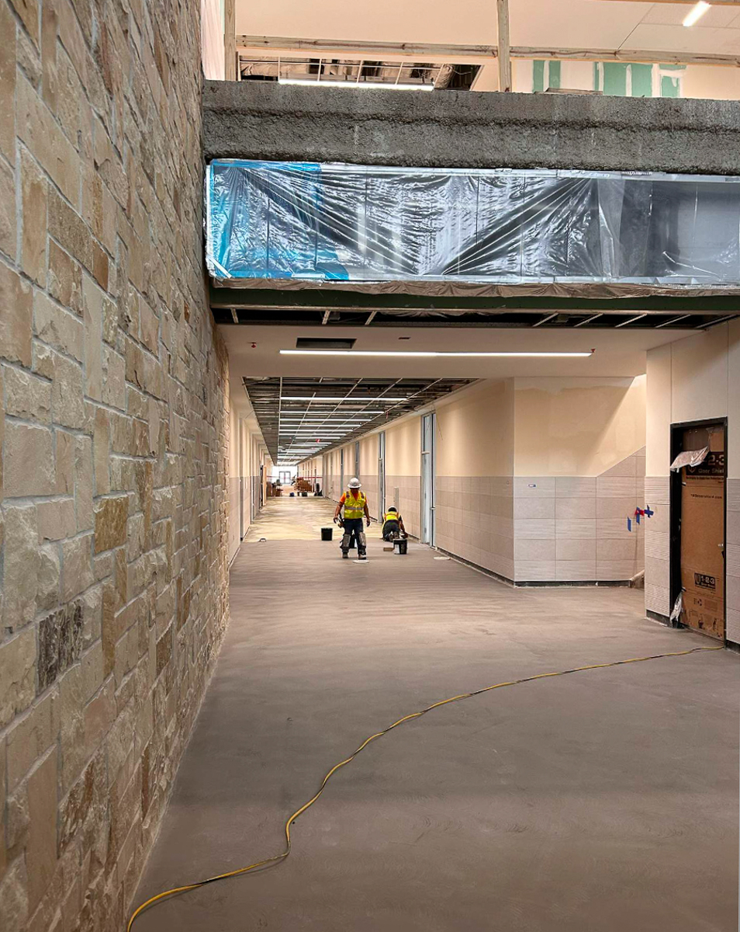
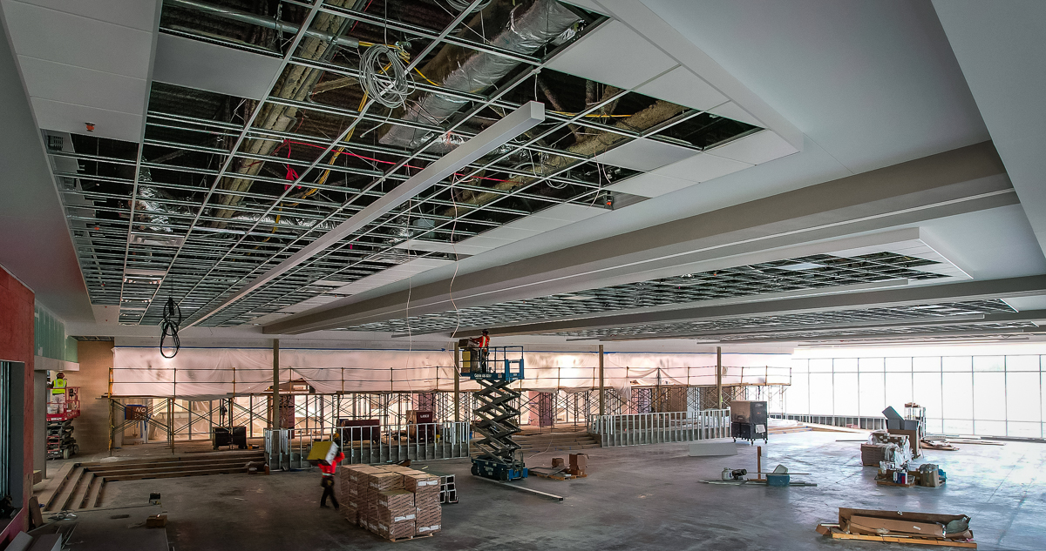
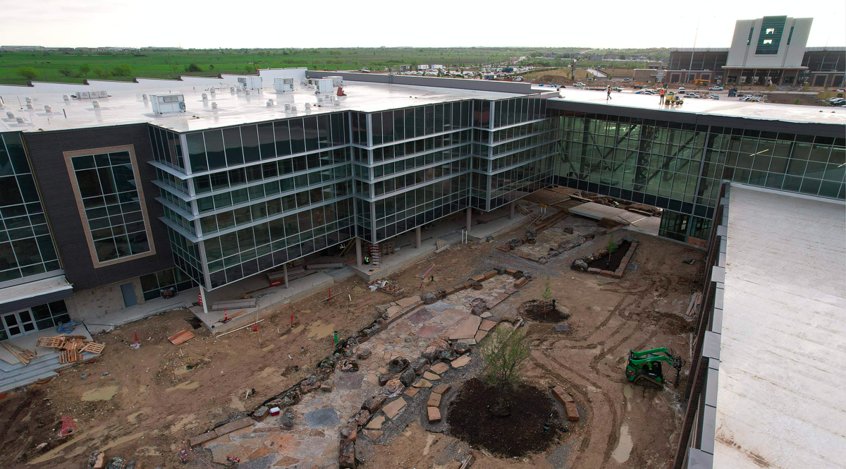
Cafeteria overhead ceiling work nearing completion. Flooring installation is scheduled for the week of April 15.
Academic building main level corridor floor installation is in progress.
Dry creek hardscape work is ongoing.

Slide 6
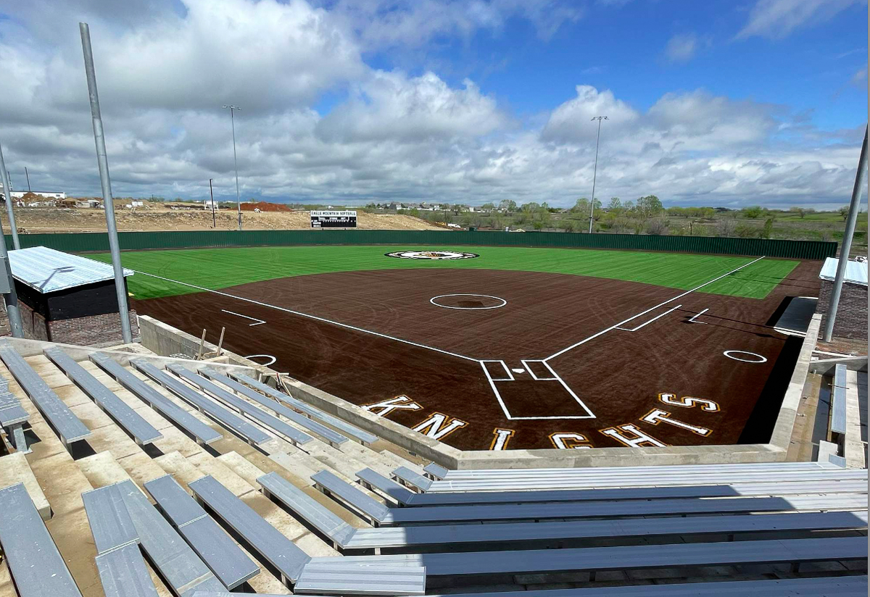
Softball field turf and seating has been installed.

Slide 7
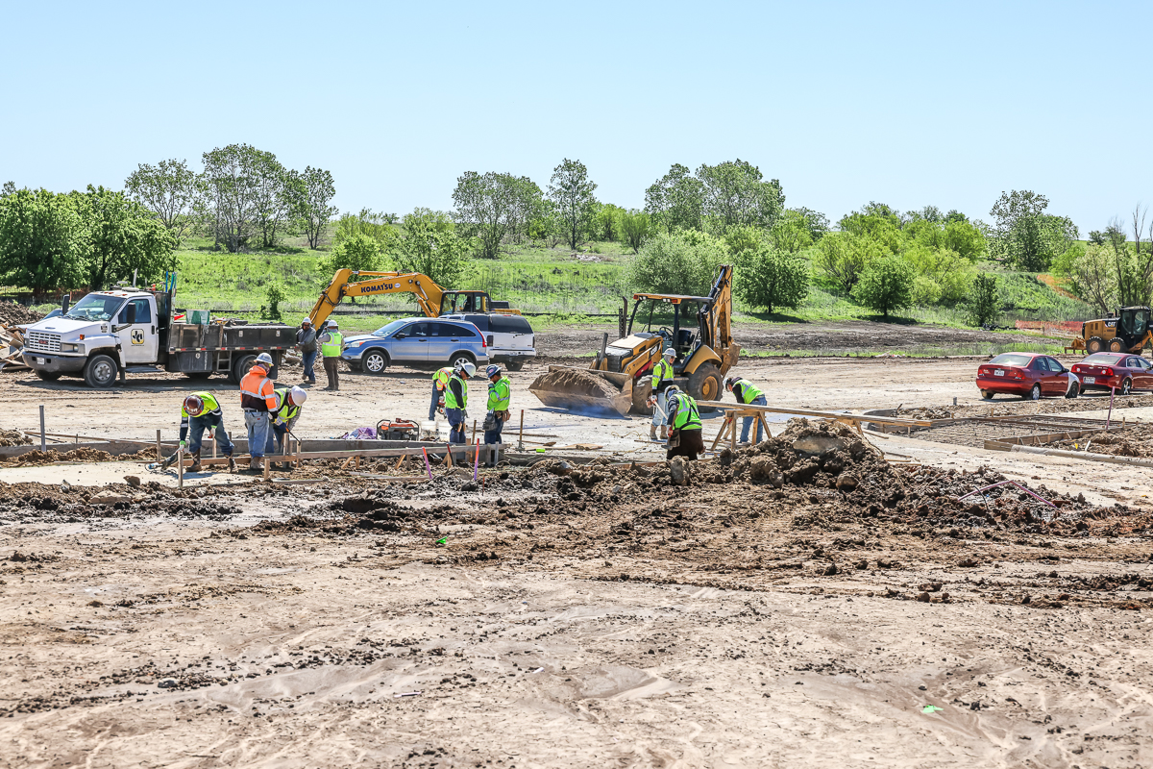
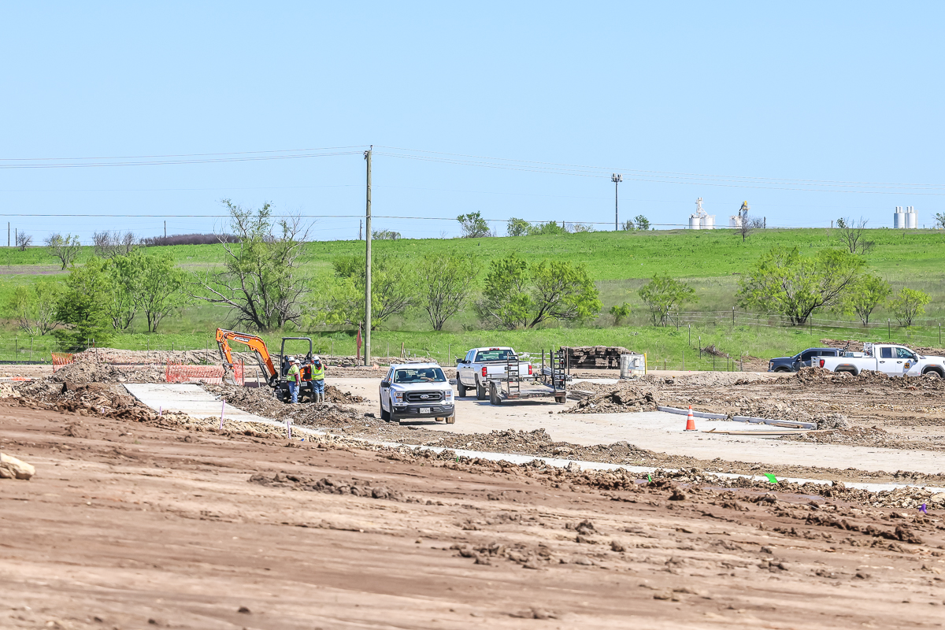
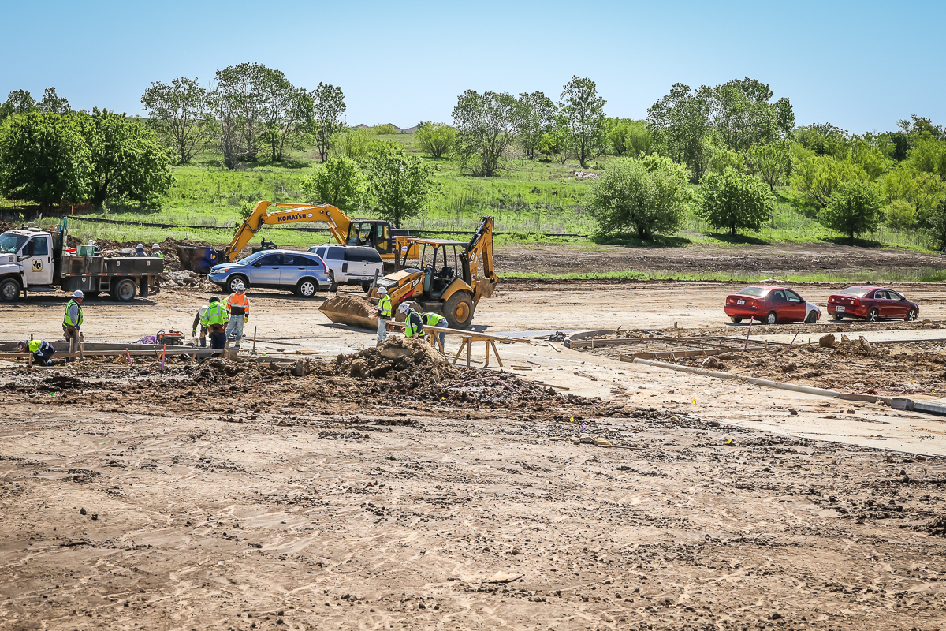
Off-side road work on Fleming Ranch Rd. is ongoing and near completion.

Slide 8
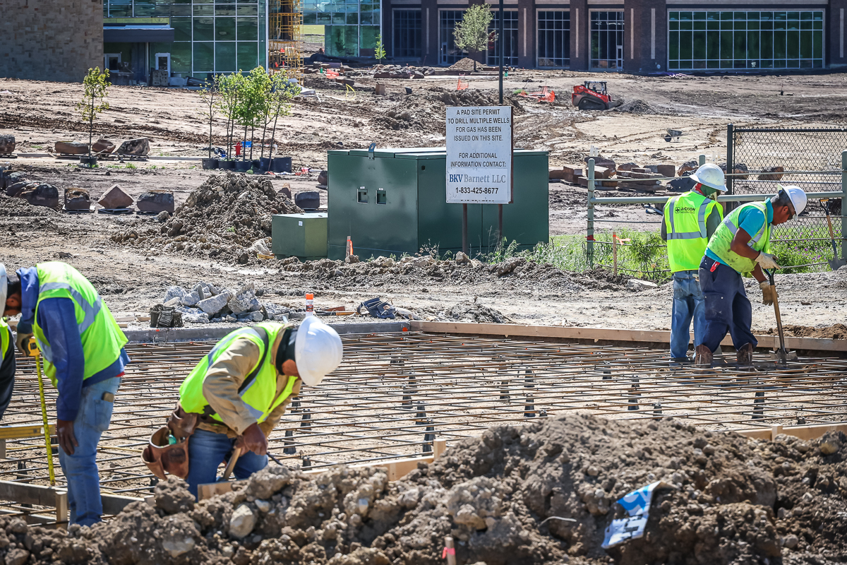
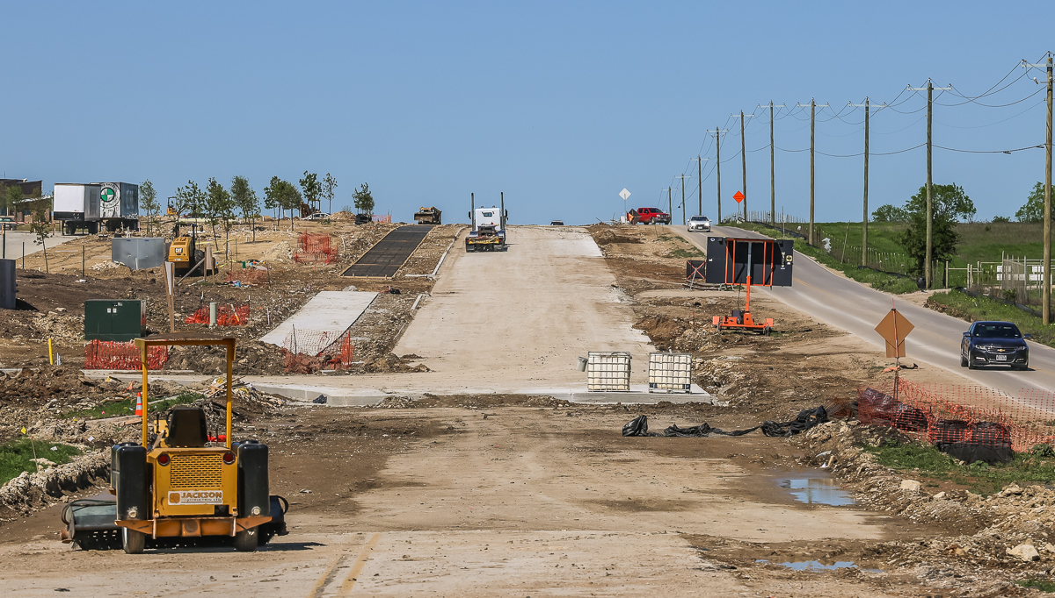
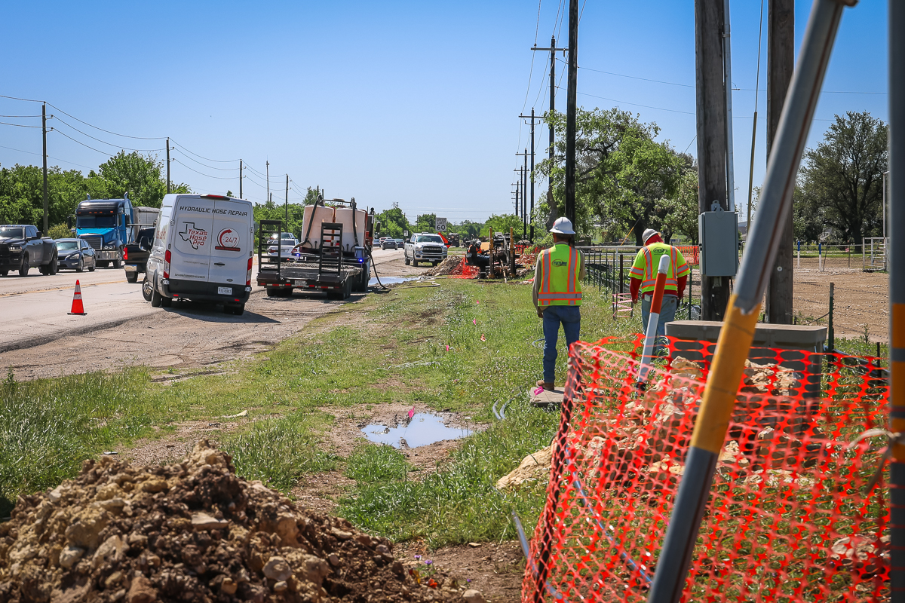
Bonds Ranch Rd. construction is ongoing and near completion.
Fiber cable is in progress along Business 287.

Slide 9
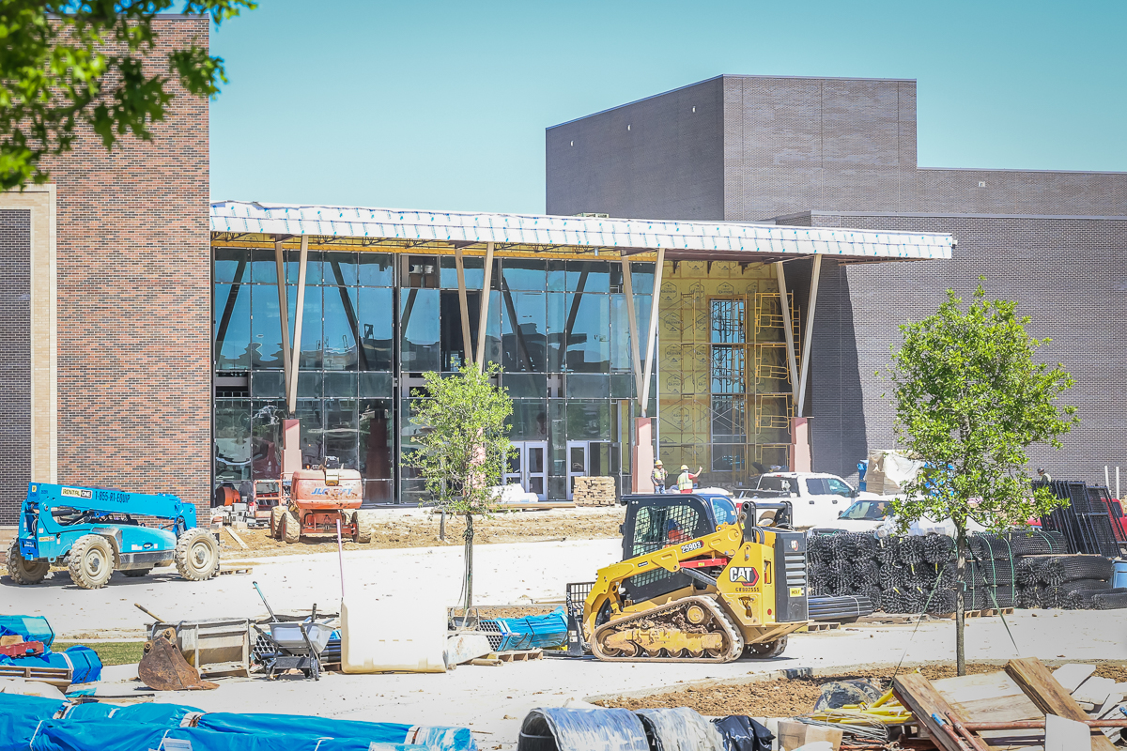
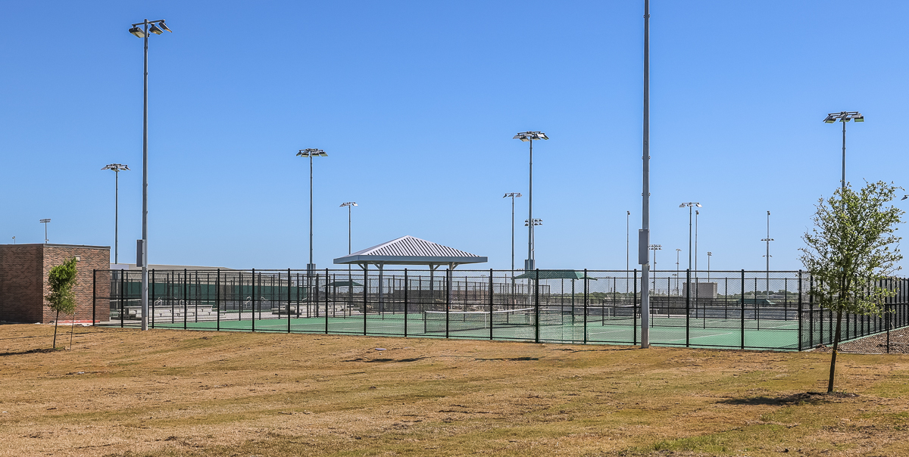
Gymnasium main entrance is near completion.
Tennis courts are near completion.

Slide 10
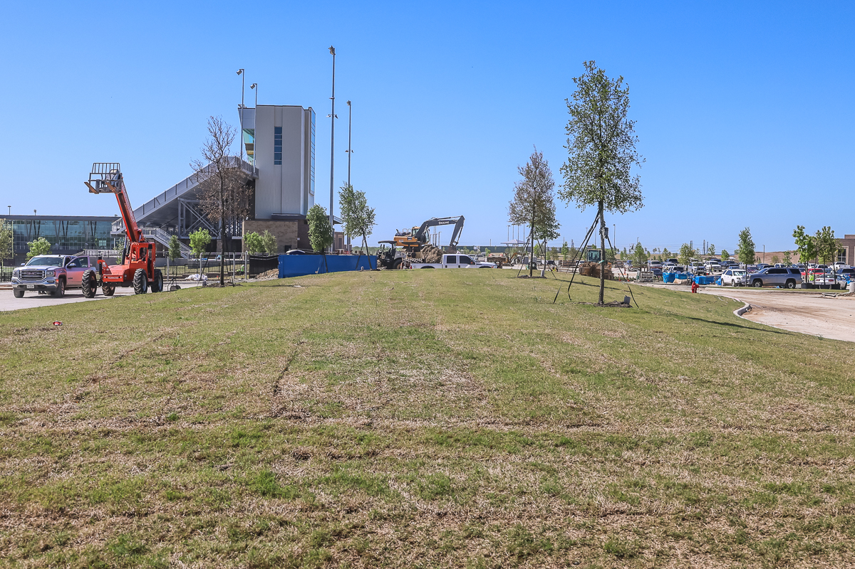
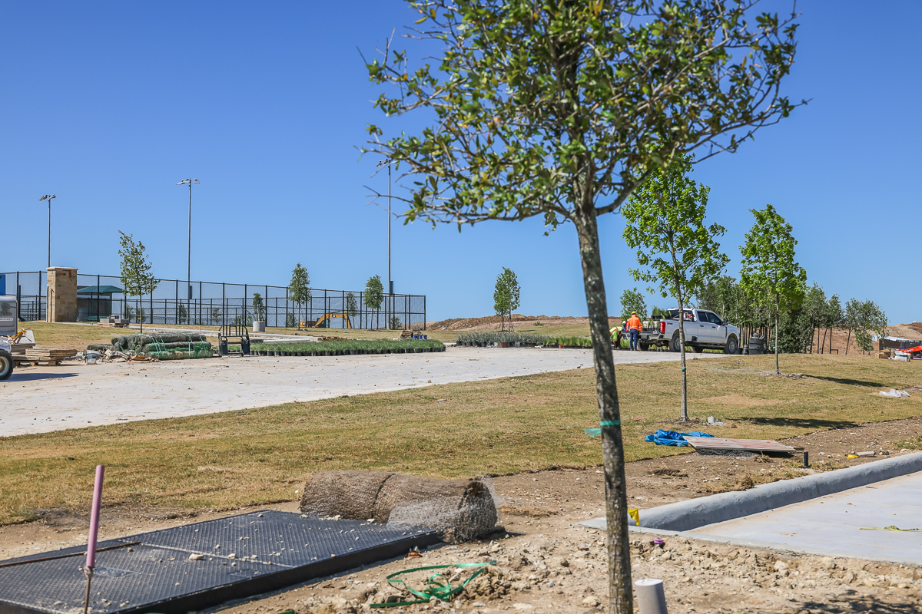
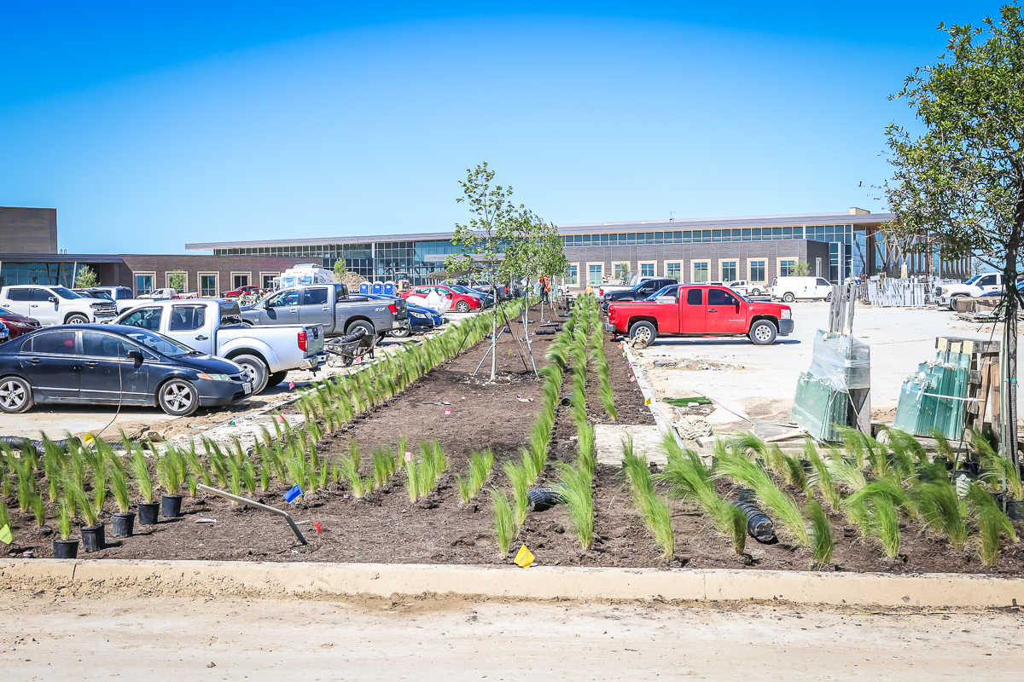
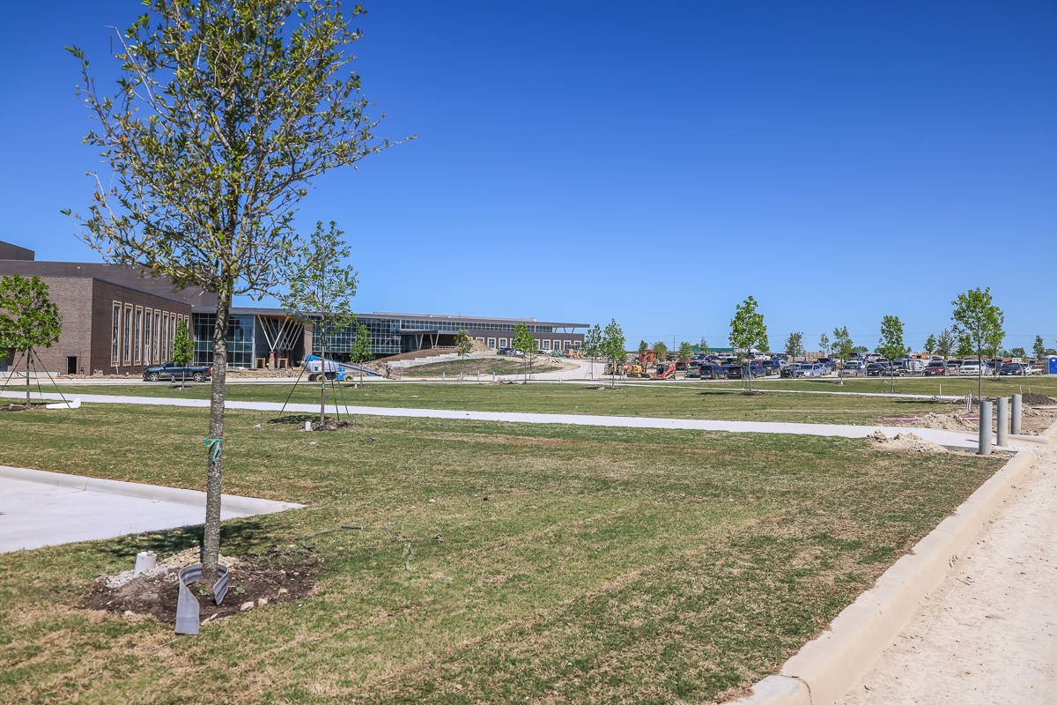
Landscaping is ongoing throughout the campus.

Slide 11
EMHS PROJECTED FINISH-OUT TIMELINE
Fieldhouse, athletic out buildings, and press box begins May 20 with furniture, fixtures, and equipment (FF&E).
Fieldhouse staff move-in on June 17.
Main building FF&E begins June 10.
Administration move-in June 27.
Remaining staff move-in July 8.
(Subject to change due to receiving proper certificate of occupancy)

Slide 12
WAYSIDE MS UPDATE
Drainage study has been submitted to the City of Saginaw for review.
Construction documents continue to be developed and reviewed by the district, contractor, architect, and City of Saginaw.
The guaranteed maximum price (GMP) demolition package will be brought to the Board for consideration tonight for a May start of demolition.
The GMP grading package will be brought to the Board for consideration in May with a May 21 start date for grading.
The remaining GMP will be brought to the Board in June for consideration.
Community meeting held April 18 at Wayside MS.
Signs have been posted to notify groups that utilize fields and parking in the construction area that they will need to relocate.
Construction fencing will be installed May 1.

